Slide 1
15-112 Term Project
Shiva Nathan

Slide 2
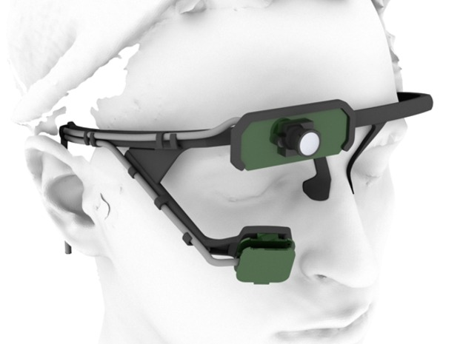
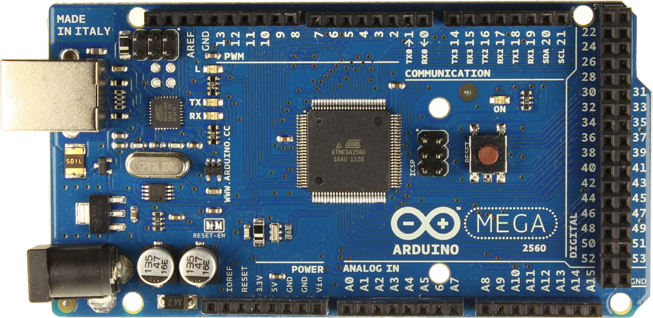
Summary
Control the fingers of a prosthetic hand based on eye movement
Pupil eye-tracking headset transmits eye coordinate data
Arduino receives data and controls prosthetic
Uses both Python and C

Slide 3
What Exists
HARDWARE
Arduino Uno
Pupil eye-tracking headset
Prosthetic hand already built
SOFTWARE
Pupil backend and UI code
Pupil can determine coordinate position of eye
Pupil can transmit data to Python server

Slide 4
My Contribution
HARDWARE
None
SOFTWARE
Python program to transmit eye coordinate data from Python server to Arduino
C program to receive eye coordinate data, parse data, and control servomotors
OVERALL
Move different fingers of hand depending on where user looks

Slide 5
Project Proposal Diagram
HARDWARE
SOFTWARE
PUPIL HEADSET
PUPIL BACKEND
PC SERVER
PYTHON SERVER
ARDUINO
ARDUINO C PARSER & CONTROLLER
SERVOMOTORS
PROSTHETIC FINGERS

